Slide 1

The Relationship Between Average Income Levels and Cultural Engagement (Cinema, Theatre) Across Regions in Turkey
Presenters:
Tevhidenur Serdar 150210335
Emir Zal Öztunç 150210334
02.01.2024
ITU Faculty of Computer and Informatics, Istanbul, Turkey

Slide 2
Problem Definition
The study formally addresses the question of how average income levels affect cultural engagement, specifically in terms of cinema and theatre participation, in different regions of Turkey.

Slide 3
Datasets and Sources
Income rate (TUİK)
Distribution of annual household disposable income by equivalent household disposable individual income across 11 regions from 2014 to 2022 (average, try)
Population (TUİK)
This dataset gives informations about population across 11 regions of residence from 2014 to 2022
Number of cinema audiances (TUİK)
Annual total number of cinema audiences across the 11 regions in Turkey from 2014 to 2022
Number of theatre audiances (TUİK)
Annual total number of theatre audiences across the 11 regions in Turkey from 2014 to 2022
Map of Turkey

Slide 4
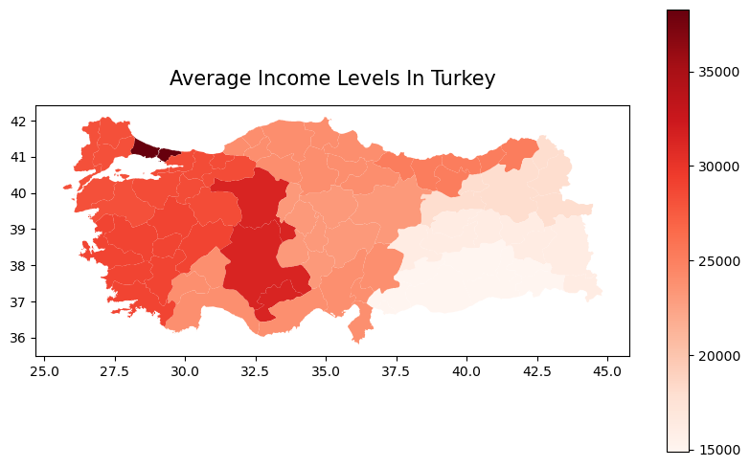
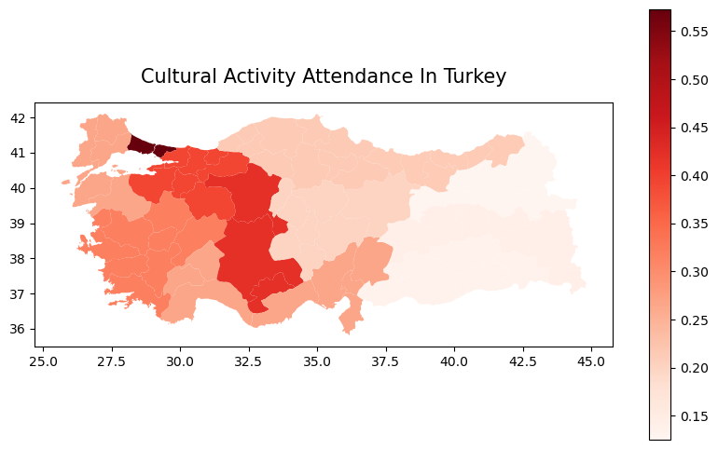
EDA (Exploratory Data Analysis)
Let's visually explore the geographical nuances through two parallel maps:
Colorization mirrors income levels and cultural activity attendance, allowing for a comparative analysis.

Slide 5
Research Question 1
Question:
What is the relationship between average income levels in different regions and participation in cinema and theatre activities?
Hypothesis:
Higher average income levels in regions correspond to increased participation in cinema and theatre activities.
Statistical Test:
Using a scatter chart with linear regression to assess the strength and direction of the linear relationship between average income levels and the number of cinema and theatre audiences.

Slide 6
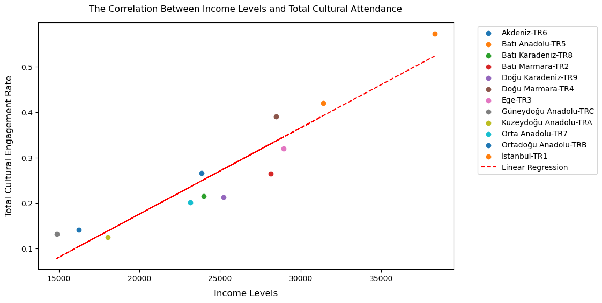
Research Question 1
Results:
Slope of the linear regression line: 1.9016012485187965e-05

Slide 7
Research Question 2
Question:
How much are cinema and theatre affected by average income levels separately? Which one is affected more by income level?
Hypothesis:
Cinema and theatre participation are positively correlated with average income levels, but theatre is more affected than cinema.
Statistical Test:
Conducting separate correlation tests for cinema and theatre participation with average income levels by using a scatter chart with linear regression.

Slide 8
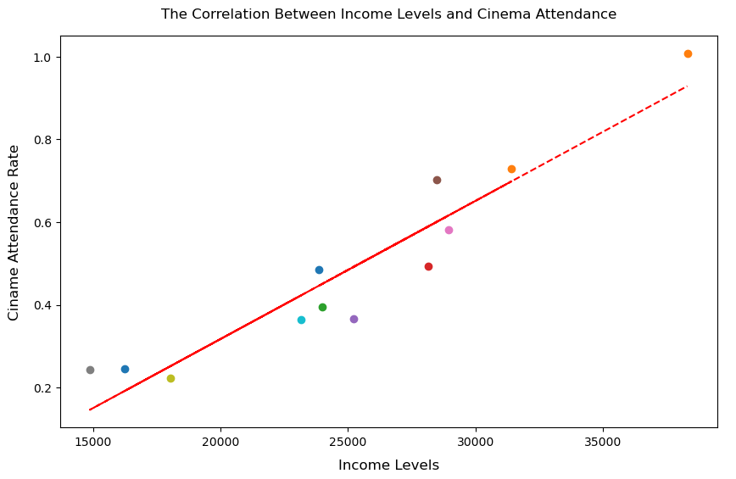
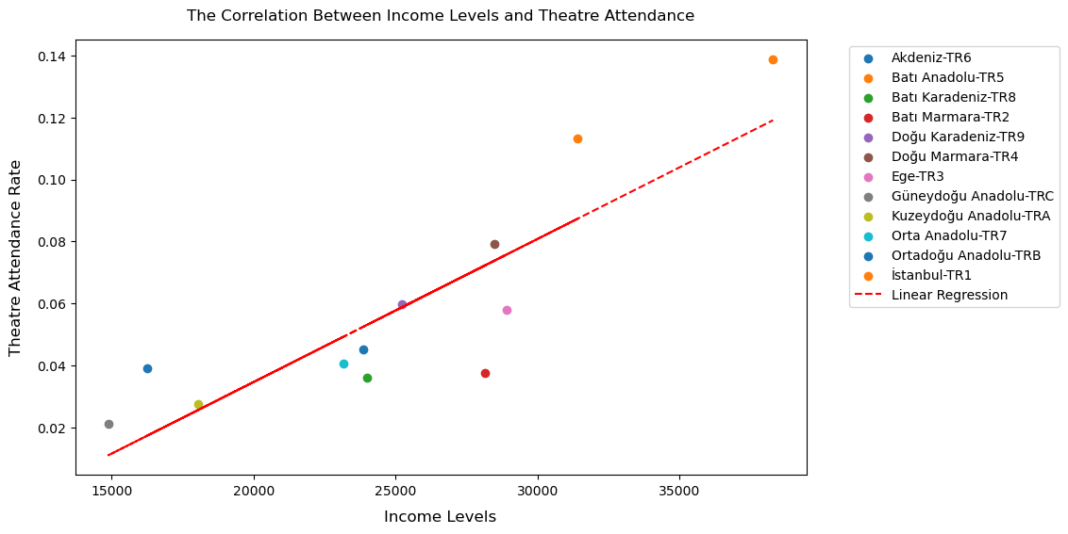
Research Question 2
Results:
Slope of the line: 3.34167107654203e-05
Slope of the line: 4.615314204955621e-06

Slide 9
Research Question 3
Question:
What regional variations exist in the context of cultural engagement and economic status?
Hypothesis:
There are regional variations in the relationship between average income levels and cultural engagement.

Slide 10
Research Question 4
Question:
Are there any observable trends or patterns in the data that suggest a causal relationship between rising or falling income levels and changes in cinema and theatre participation?
Hypothesis:
Changes in income levels are causally related to changes in cinema and theatre participation.

Slide 11
Potential products
Cultural Marketing Strategies
Mobile App for Cultural Recommendations
Policy Recommendations

Slide 12
Any issues related to data engineering.
Data Integration Challenges
Large-Scale Data Processing
Data Quality Assurance

Slide 13
Any issues related ethics.
Privacy Protection
  Handling sensitive data related to income levels and individual engagement raises privacy concerns.
Data Ownership and Usage Rights
  Clarifying who owns the data and how it will be used is an ethical concern, especially when utilizing datasets from external sources.

Slide 14
Conclusion
In summary, this project explored the interplay between average income levels and cultural engagement, specifically in cinema and theatre, across Turkish regions from 2014 to 2022. Leveraging datasets from the Turkish Statistical Institute, our analysis aimed to discern the impact of income on cultural participation, identify regional variations, and uncover trends over time. The findings provide valuable insights for policymakers and contribute to understanding the dynamics of cultural engagement in diverse provinces of Turkey.

